Slide 1
CloakSphere: A Framework for IDS Evasion and Pentesting
Sunil Upadhyay (240043001016)

Slide 2
Table of Contents
Understanding Snort Rules
Types of Detection Techniques
SSH Authentication Detection
SSH Brute-force Detection
Improper Input Validation Detection
SQL Injection Detection
Unauthorized File Upload Detection
XSS Detection

Slide 3
Understanding Snort Rules
1. What Are Snort Rules?
Snort rules define the conditions under which traffic is flagged as suspicious or malicious.
These rules consist of header (which specifies protocol, IP addresses, ports) and options (which define the detection criteria).
2. Structure of a Snort Rule
A Snort rule has the following format:
action protocol source_IP source_port -> destination_IP destination_port (rule options)
3. Types of Snort Rules
Detection Rules – Identify attacks (e.g., SQL injection, XSS).
Prevention Rules – Block malicious traffic.
Logging Rules – Record suspicious activities for analysis.

Slide 4
Types of Detection Techniques
1. Signature-Based Detection
Also known as rule-based detection.
Works by comparing network traffic against a predefined set of attack signatures.
If an exact match is found, an alert is generated.
alert tcp any any -> any 80 (msg:"SQL Injection Attempt"; content:"SELECT"; http_uri; nocase; sid:1002;)
Detects requests containing SQL keywords like SELECT in the URL.
Case-insensitive match using nocase option.
2. Regular Expression (RegEx)-Based Detection
Uses pattern matching techniques to detect attacks.
More flexible than signature-based detection because it can identify variations of an attack.
Commonly used in Snort’s PCRE (Perl-Compatible Regular Expressions) option.
alert tcp any any -> any 80 (msg:"XSS Attempt"; pcre:"/<script.?>.?</script>/Ui"; sid:1003;)
Uses regular expressions to detect <script> tags in web traffic.
U → Non-greedy matching, i → Case-insensitive.

Slide 5
SSH Authentication Detection
1. Purpose of the Rule
The goal of this rule is to detect SSH authentication attempts within the network. SSH (Secure Shell) is commonly used for remote administration, and monitoring authentication attempts helps identify potential unauthorized access or brute-force attacks.
alert tcp any any -> $HOME_NET any (msg: "SSH Authentication Attempt Detected !!"; sid:100002; rev:1;)
alert → Generates an alert when the rule condition matches.
tcp → Monitors TCP traffic, as SSH operates over TCP.
any any → Checks for traffic from any source IP and port.
$HOME_NET any → Targets any destination within the internal network.
msg: → Displays a message when an alert is triggered.
sid: → Unique identifier for the rule.
rev: → Revision number for version control.

Slide 6
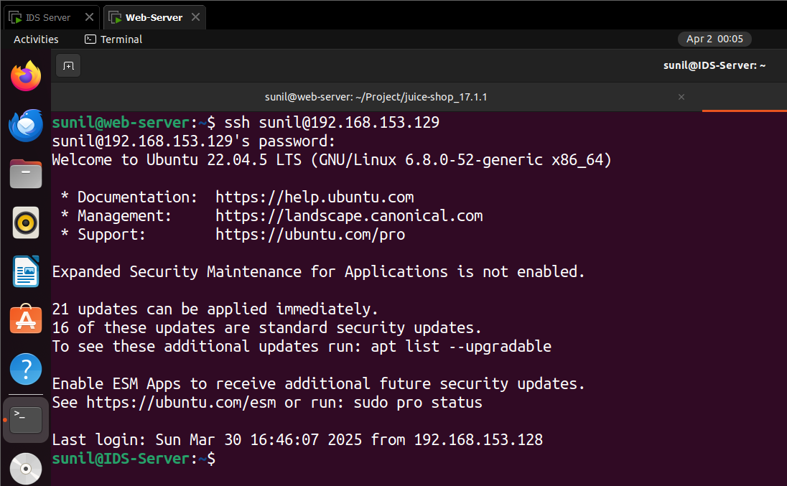
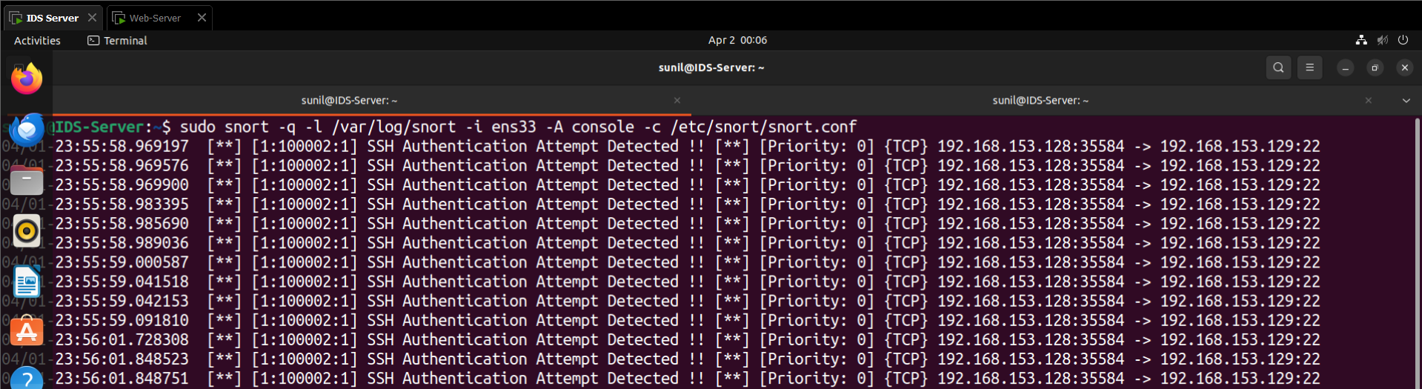

Slide 7
SSH Brute-force Detection
1. Purpose of the Rule
The goal of this rule is to detect SSH brute-force attacks, where an attacker rapidly attempts multiple login attempts using tools like Hydra. Brute-force attacks can lead to unauthorized access, so detecting them is crucial for network security.
alert tcp any any -> $HOME_NET any (msg: "Possible SSH Brute Force Attempt"; flow:to_server, established;
content:"SSH-2.0-"; depth:10; detection_filter:track by_src, count 5, seconds 30; classtype:attempted-admin;
sid:100004; rev:1;)
flow:to_server, established → Ensures traffic is directed toward the SSH server and is part of an established connection.
content:"SSH-2.0-" → Matches the SSH protocol version banner, confirming SSH traffic.
depth:10 → Limits content inspection to the first 10 bytes to improve efficiency.
detection_filter:track by_src, count 5, seconds 30 → Triggers an alert if 5 or more SSH login attempts occur from
the same source within 30 seconds.
classtype:attempted-admin → Classifies the alert as an attempted administrative attack.

Slide 8
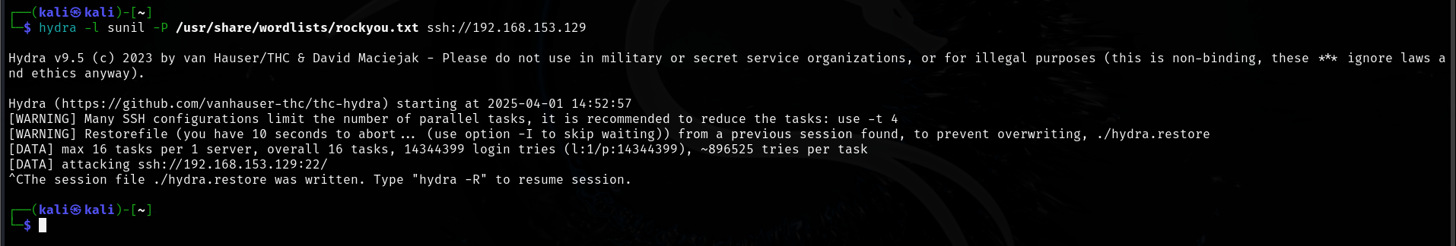
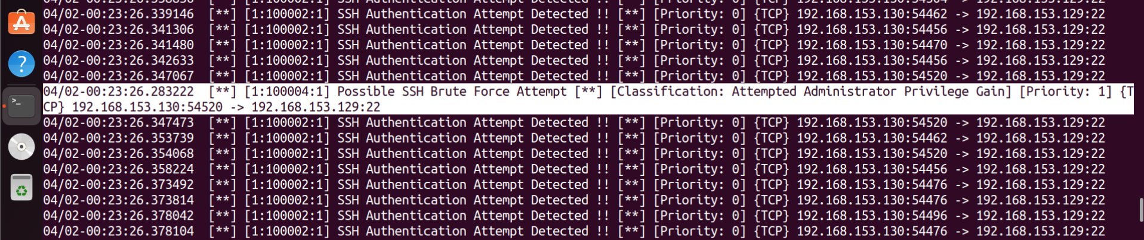

Slide 9
Improper Input Validation Detection
1. Purpose of the Rule
This rule detects improper input validation in applications, specifically when a user modifies the rating parameter in an HTTP request. If an application is not properly validating user input, attackers can manipulate data, potentially leading to business logic flaws or security vulnerabilities.
alert tcp any any -> any 3000 (msg:"Suspicious Improper Input Validation Detected";
content:"\"rating\":"; pcre:"/\"rating\":\s*[3-9]/"; nocase; sid:1000001; rev:2;)
content:""rating":" → Looks for the rating field in an HTTP request.
pcre:"/"rating":\s[3-9]/"* → Uses a regular expression (RegEx) to detect if the rating value is 3 or higher
\s* → Allows for any amount of whitespace before the number.
[3-9] → Detects ratings from 3 to 9 (modified values).
nocase → Makes the detection case-insensitive.

Slide 10
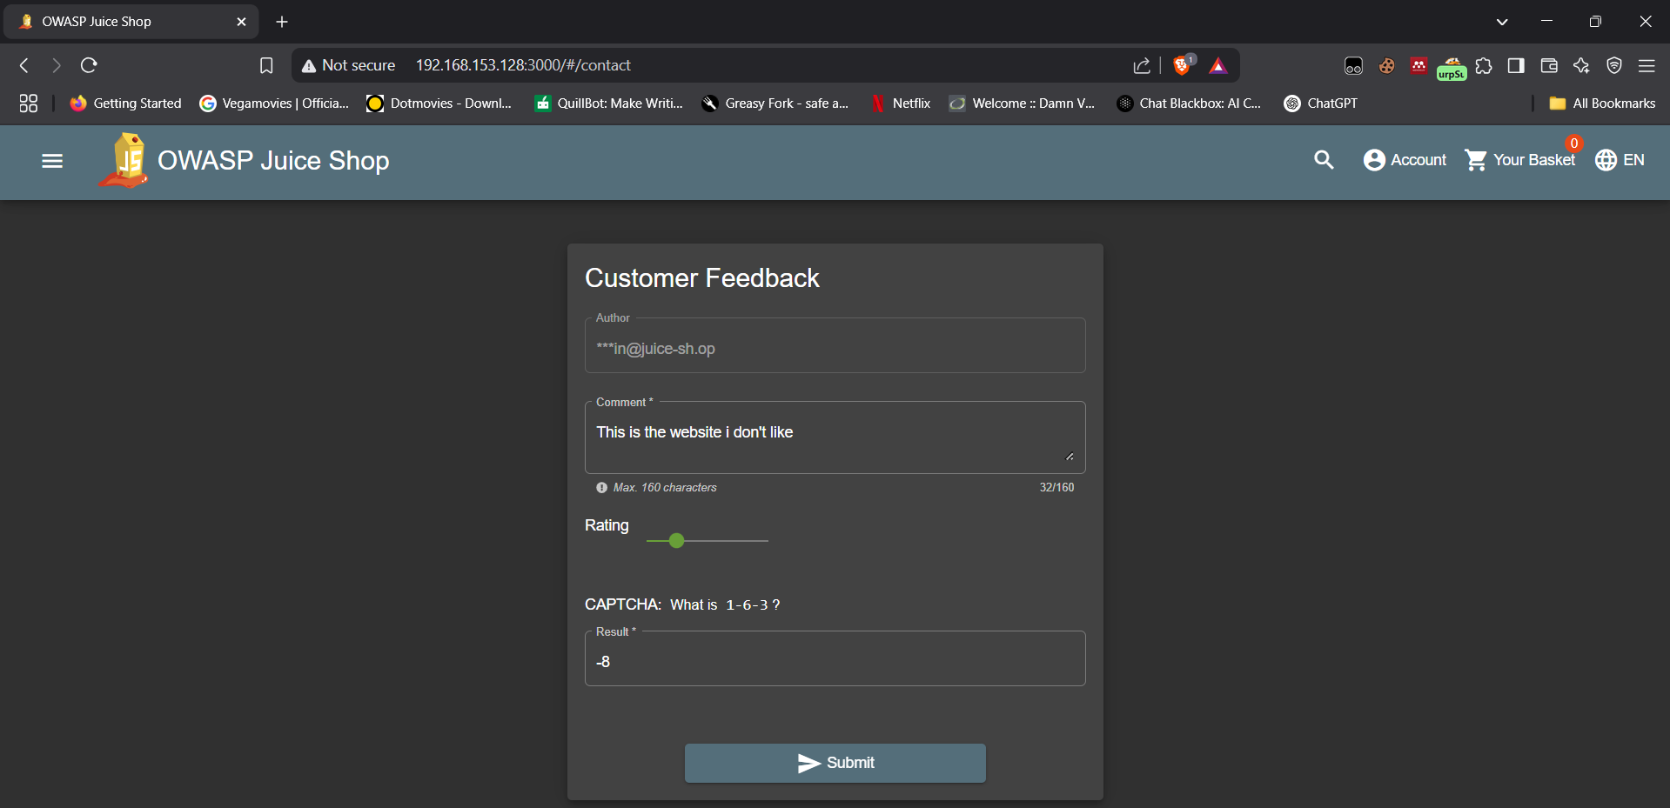
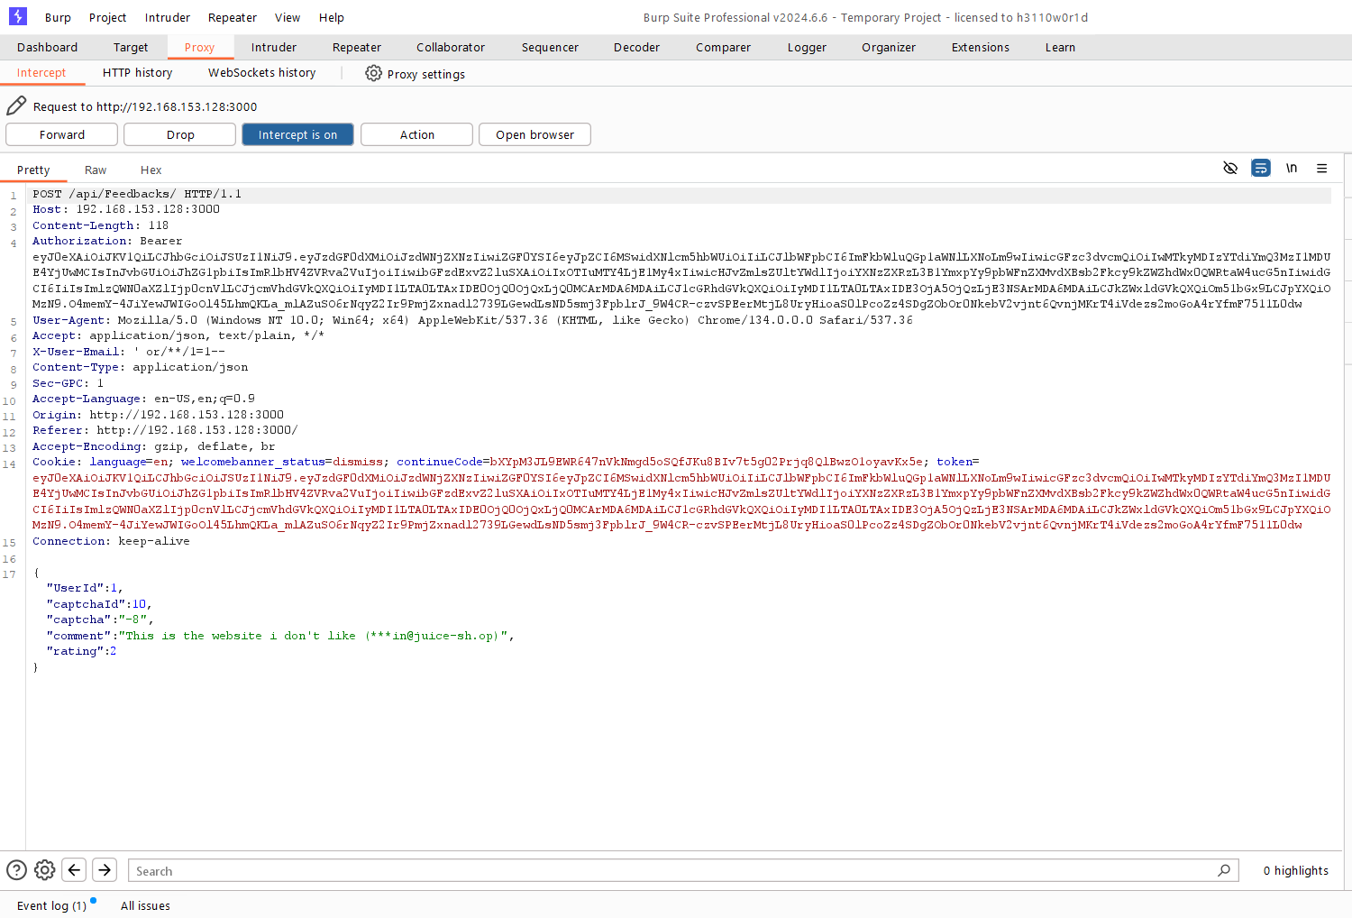

Slide 11
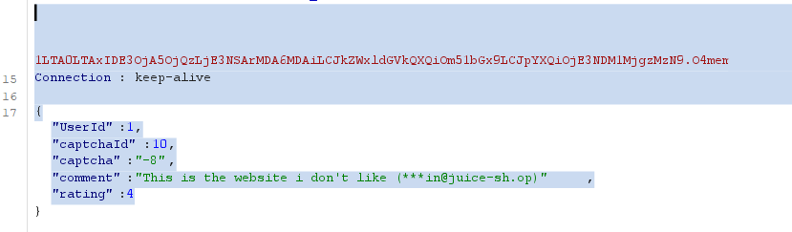
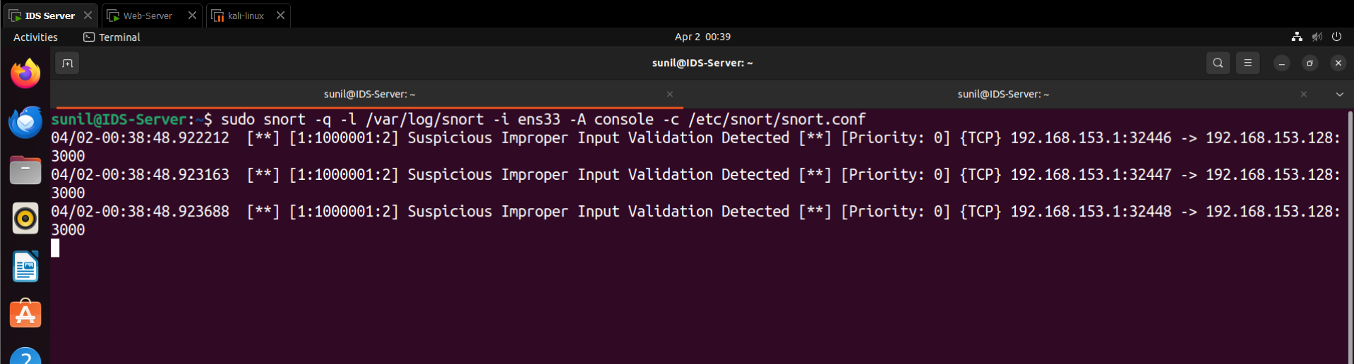

Slide 12
SQL Injection Detection
1. Purpose of the Rule
This rule detects SQL Injection (SQLi) attempts, specifically boolean-based SQL injection where an attacker manipulates the email parameter in an HTTP POST request. SQLi attacks can allow attackers to bypass authentication, extract sensitive data, or manipulate database queries.
alert tcp any any -> 192.168.153.128 3000 (msg:"SQL Injection Attempt Detected"; flow:to_server,established;
content:"POST"; http_method; content:"email"; http_client_body; content:"or 1=1"; nocase; sid:1000011; rev:3;)
content:"POST"; http_method → Matches HTTP POST requests, commonly used for form submissions.
content:"email"; http_client_body → Ensures the request body contains the email parameter, which is being targeted.
content:"or 1=1"; nocase → Detects the classic SQL injection payload or 1=1, which always evaluates to true,
allowing attackers to bypass authentication.

Slide 13
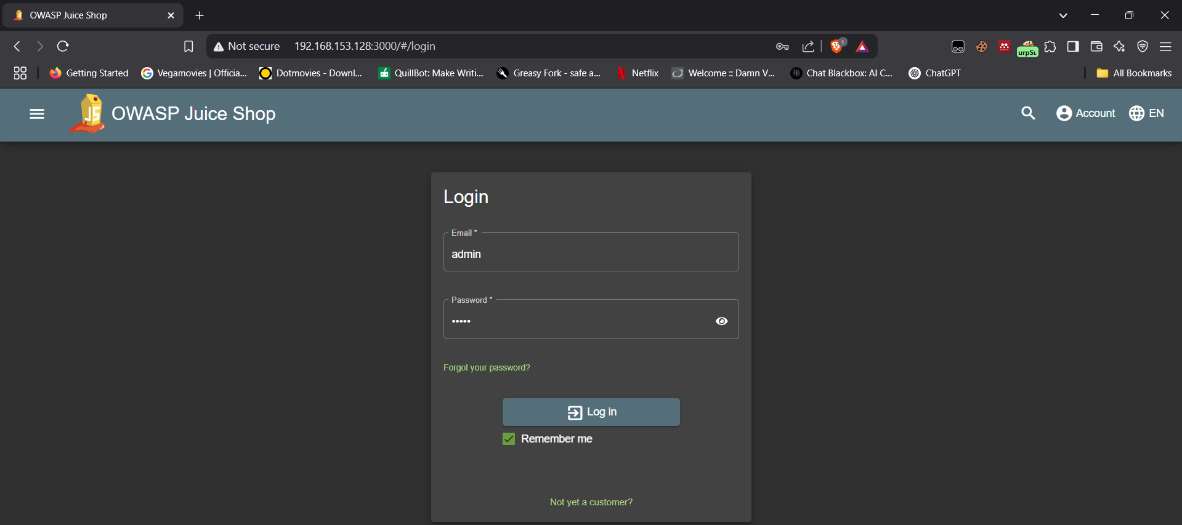
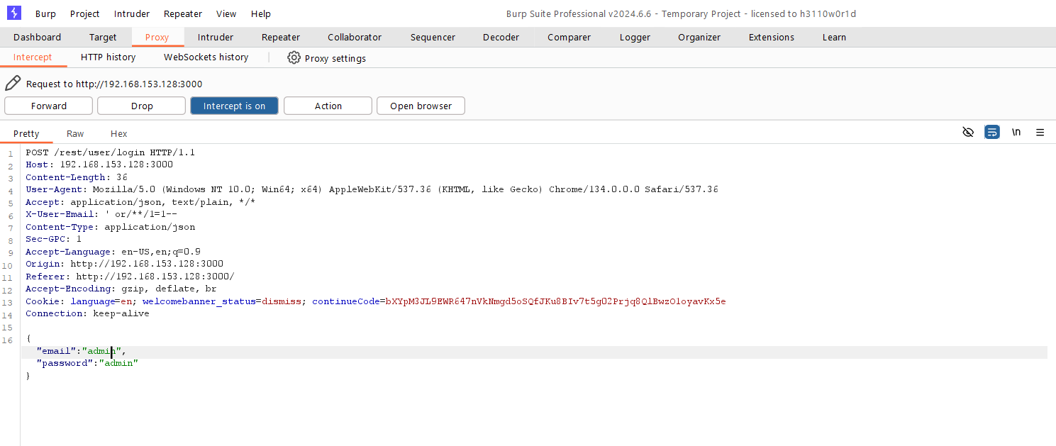

Slide 14
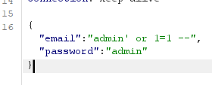
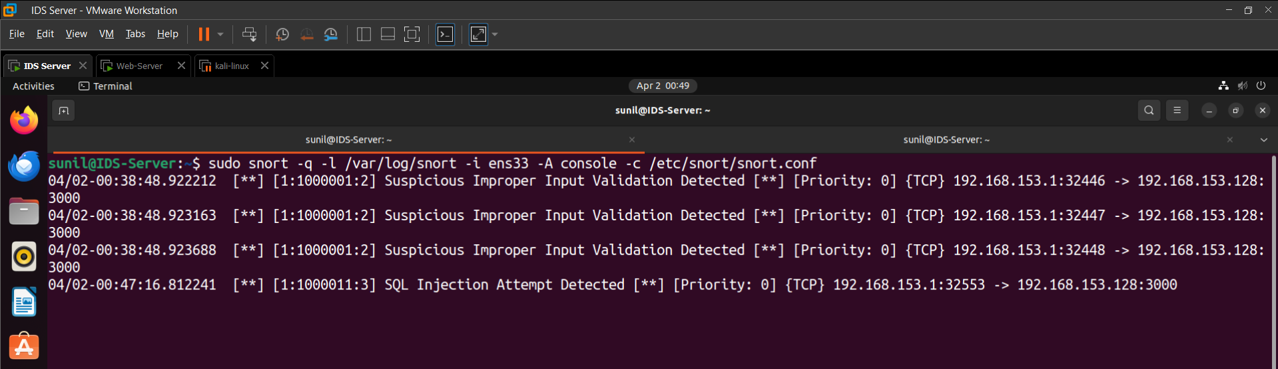
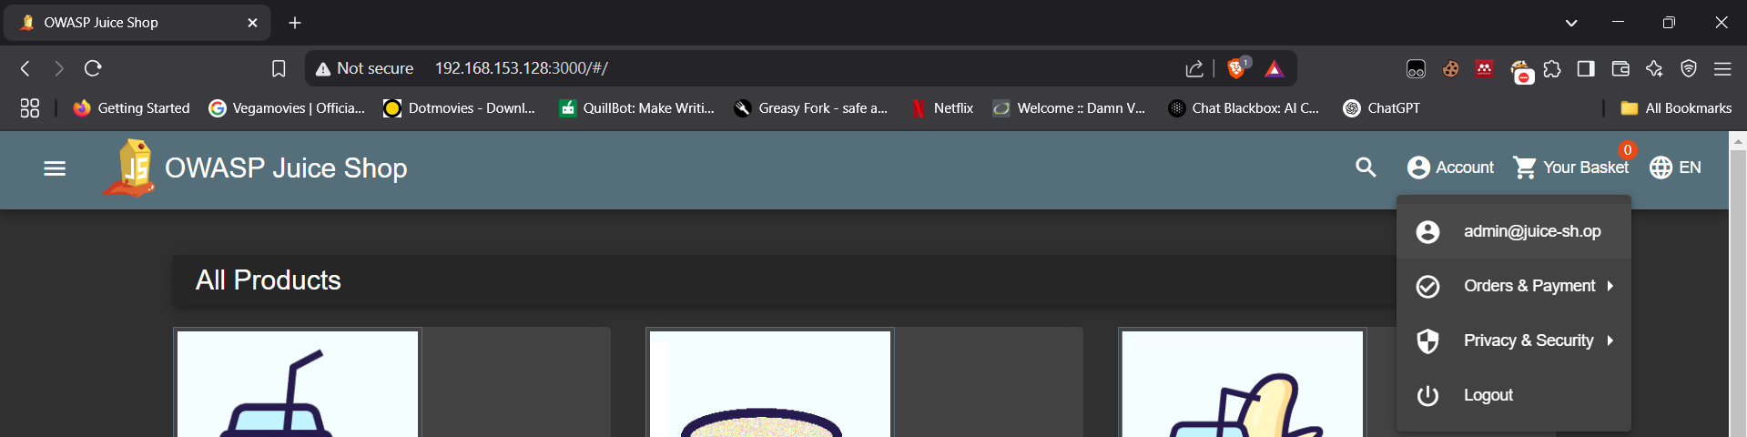

Slide 15
Unauthorized File Upload Detection
1. Purpose of the Rule
This rule detects unauthorized file uploads, where users attempt to upload files other than PDF or ZIP. Attackers often upload malicious files (e.g., .xml, .php, .exe) to exploit vulnerabilities in web applications, leading to remote code execution, data leaks, or privilege escalation.
alert tcp any any -> any any (msg:"Unauthorized file upload detected"; content:"Content-Type:";
nocase; pcre:"/Content-Type:\s*(?!application\/pdf|application\/zip)/"; sid:100002; rev:1;)
pcre:"/Content-Type:\s(?!application/pdf|application/zip)/"* → Uses a regular expression (RegEx) to check the file type.
(?!application\/pdf|application\/zip) → Negative lookahead to detect files other than PDF or ZIP.

Slide 16
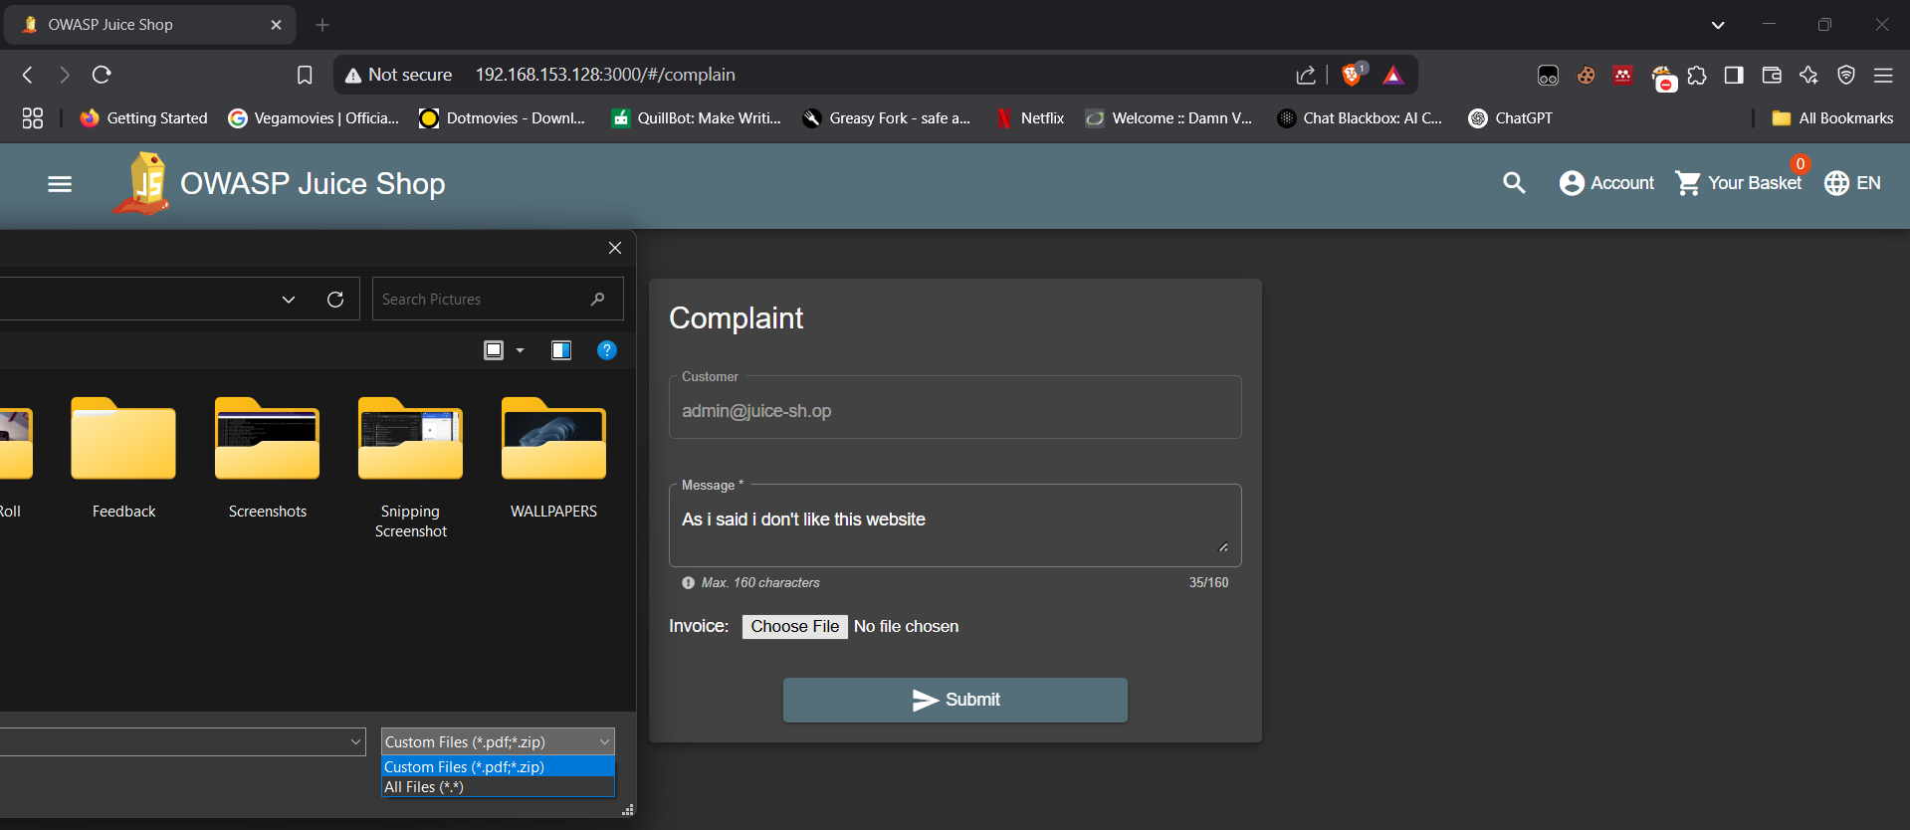
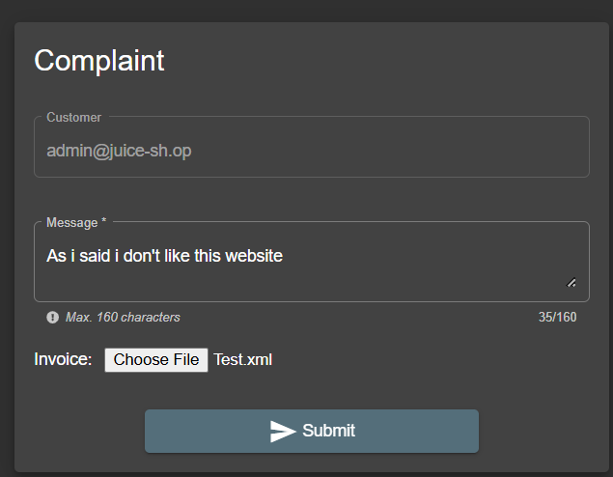
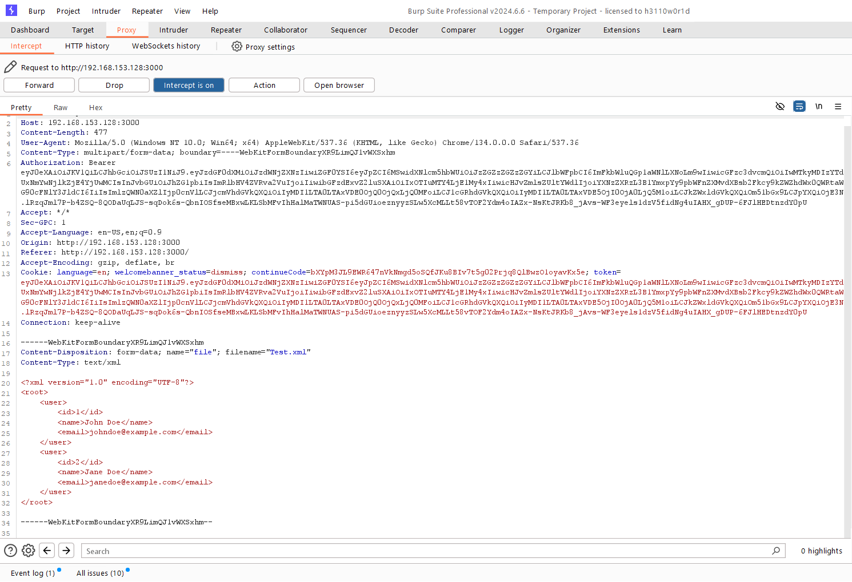

Slide 17
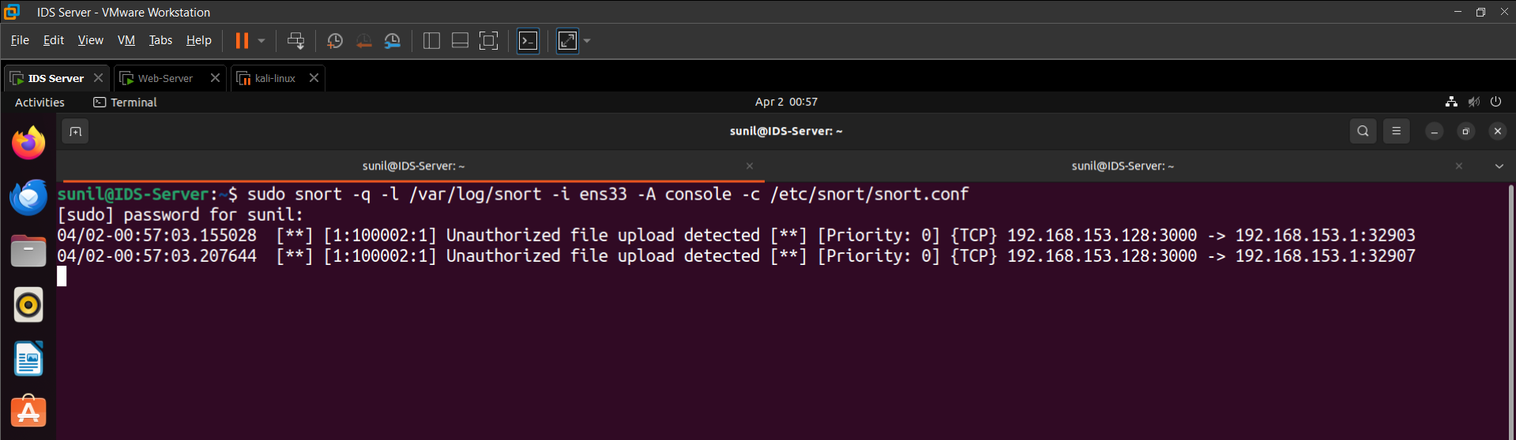

Slide 18
Reflected Cross-Site Scripting (XSS) Detection
1. Purpose of the Rule
This rule detects reflected XSS attempts, where attackers inject malicious scripts into a website’s URL or parameters to execute JavaScript in a victim’s browser. Reflected XSS is often used to steal session cookies, perform phishing attacks, or hijack user accounts.
alert tcp any any -> any any (msg:"XSS Attempt Detected - Reflected XSS"; content:"<iframe"; nocase;
content:"src="; nocase; content:"javascript:alert("; nocase; http_uri; sid:1000001; rev:1;)
content:"<iframe"; nocase → Searches for <iframe> tags, commonly used in XSS attacks.
content:"src="; nocase → Ensures the attack contains a source attribute for embedding malicious scripts.
content:"javascript:alert("; nocase → Matches javascript:alert() payloads, often used in basic XSS testing.
http_uri → Limits detection to URLs and parameters in HTTP requests.

Slide 19
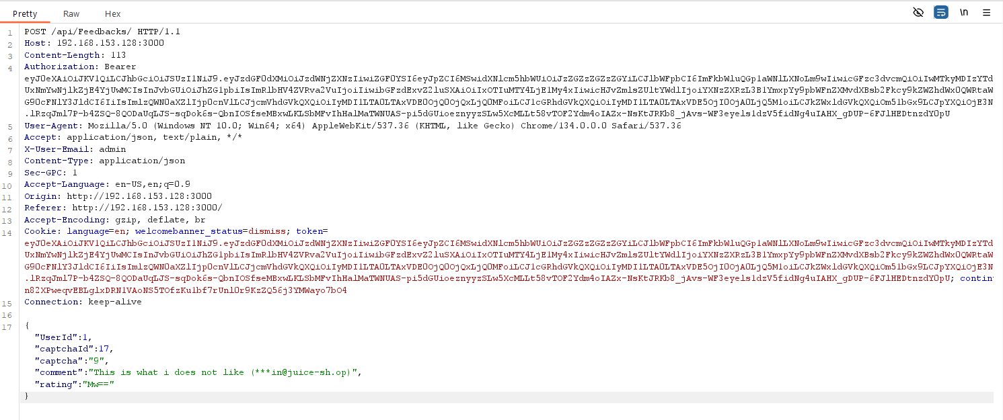
Evasion Techniques Overview
1. Base64 Encoding
Instead of sending raw values in JSON parameters, attackers encode them using Base64. Since Snort's rule is searching for rating values between 3-9, encoding the value hides it from simple content-based detection.victim’s browser. Reflected XSS is often used to steal session cookies, perform phishing attacks, or hijack user accounts.

Slide 20

Evasion Techniques Overview
2. Bypassing SQL Injection Detection
SQL supports inline comments (/**/), allowing attackers to break up the query to bypass string-based detection.
The Snort rule looking for "or 1=1" won't match because the content is split. The database still executes the query correctly.

Slide 21
Thank You !!

